Slide 1
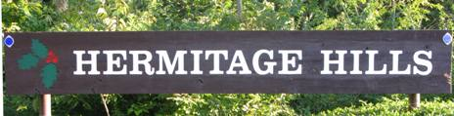
Hermitage Hills Home Owner’s Association
Spring 2018 Meeting
Please be courteous to others and mute all cell phone ringers.

Slide 2
Agenda
Welcome and Introduction
State of the subdivision
  Common Grounds repair update
  Road Repair updates
Assessment billing and Revenue reports
Ballot Items
Questions and Answers
Conclusion and Collection of Ballots
Notes:
This is a business meeting We ask that you please not interrupt the presentation because we have lots of material to present.
Please save your questions for the question and answer period at the end. All the questions and answers will be posted on the website. (and mailed out with the results of the vote.
Anyone causing repeated interruptions will be asked to leave.
As a precaution, if needed, we do have a security officer present to help escort them out.
New trustees: Joe Marcantano

Slide 3
State of the Subdivision
Lake and Common Grounds:
January: Survey of common ground property lines was completed.
April: The brush on and below the dam was cleared, landscaping performed, and the spillway was replaced.
$9,650.00 paid so far, still owe $24,500.00. Will pay ½ this summer, rest by April 1, 2019.
Notes:
We’ve applied for a grant from Mo DOC for lake improvements. If its approved we will receive $750.00 per year.
It does require that we open the lake to public fishing, but no one monitors its use now.
We hope to do spillway repair next year to begin upgrading the lake.

Slide 4
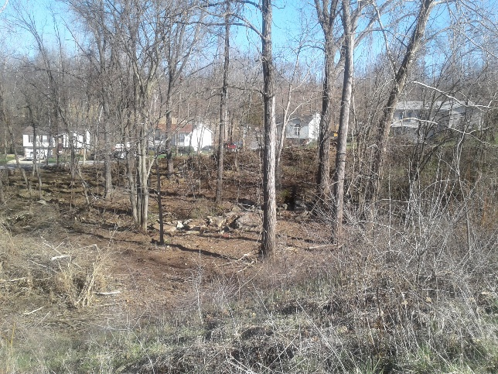

Slide 5
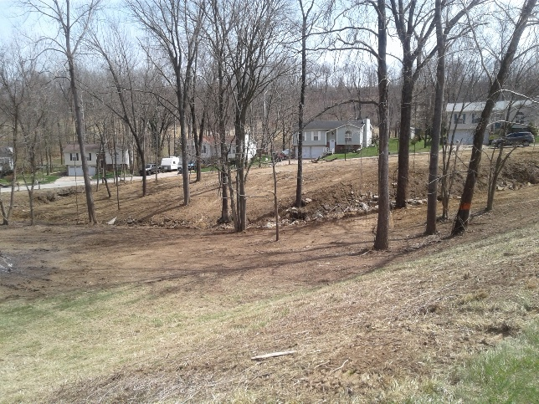

Slide 6
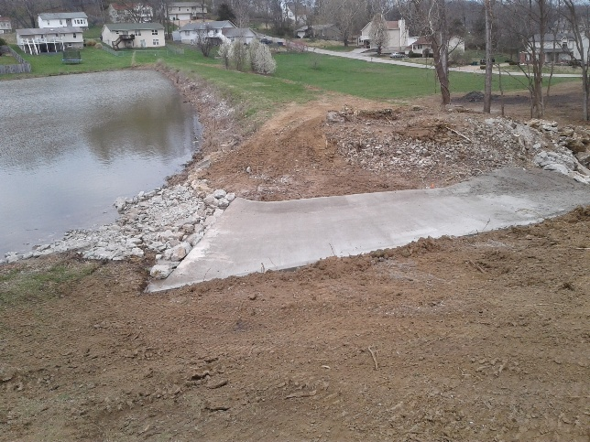

Slide 7
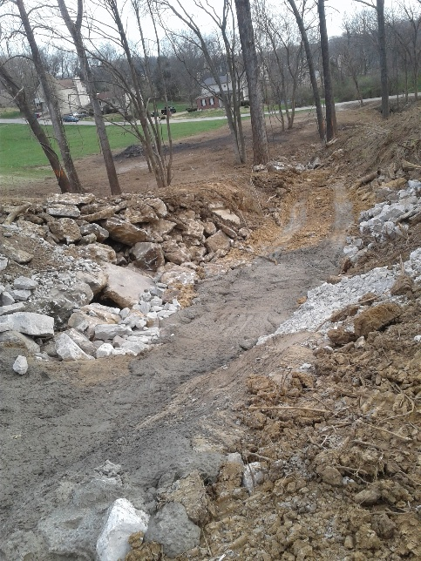

Slide 8
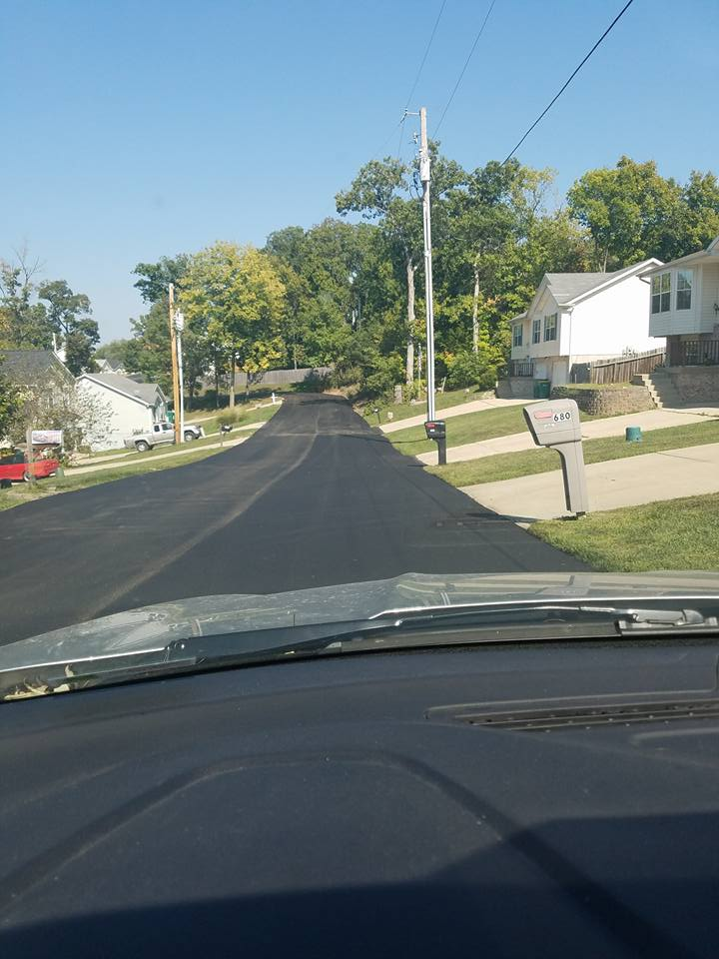
Road Repairs

Slide 9
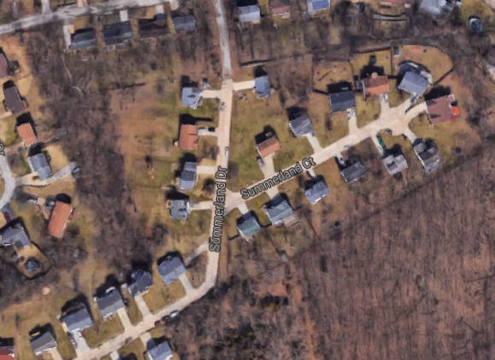
Completed Road Repairs
Summerland Drive, Summerland Court and the concrete portion of Walnut Ridge Drive.
$79,400
Completed in 2017
6,000 sq ft concrete
patched, Pave entire
concrete area with
Asphalt

Slide 10
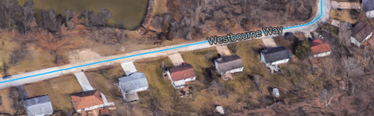
2018 Planned Road Repairs
Westbourne (Unpaved area to Parking Pad)
$38,650
Dig out deteriorate area, install new base. Repave with 2 layers of asphalt to the corner of Turnbridge.

Slide 11
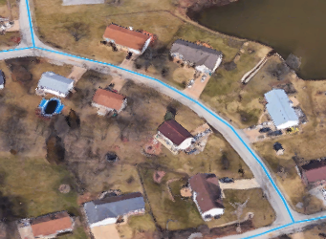
2018 Planned Road Repairs
Hermitage (High Cliff to Westbourne)
$27,000
Dig out deteriorated areas, repair, and repave with 2 layers of asphalt.

Slide 12
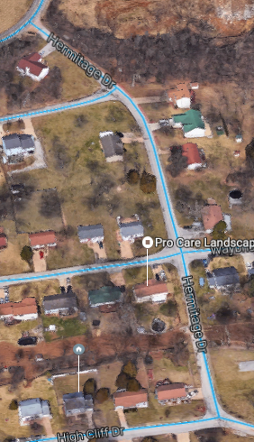
2018 Planned Road Repairs
Hermitage (Saline to High Cliff)
$54,930
Repave with 2 layers of
asphalt over entire area

Slide 13
2018 Planned Road Repairs
We had these 3 projects were originally bid as separate projects for a total of $120,580.00
The bid to do all 3 at once is $64,800.00
The work will be done this summer.
Other work planned: Pothole Patching and Repairs on Lazy Oak entrance.

Slide 14
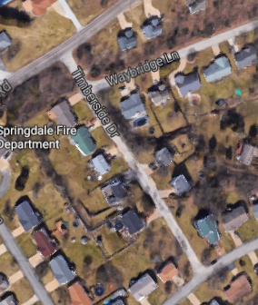
Future Planned Road Repairs
Timberside
$30,750
Repair and Repave from
Saline to Walnut Ridge

Slide 15
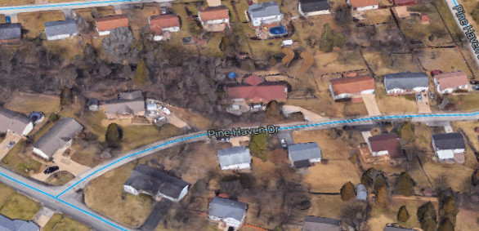
Future Planned Road Repairs
Upper Pine Haven Drive
$48,000
Dig out and re-pave with 2 layers of asphalt from Walnut Ridge to curve.
Replace 200 ft curbing

Slide 16
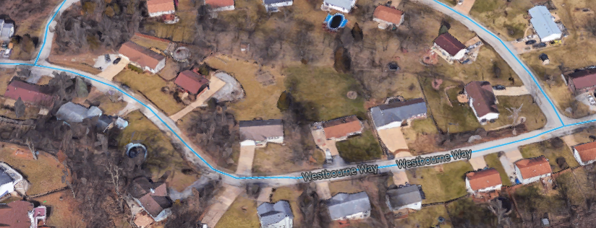
Future Planned Road Repairs
Westbourne (High Cliff to Hermitage)
$38,755
Dig out and repair corner, Pave entire section

Slide 17
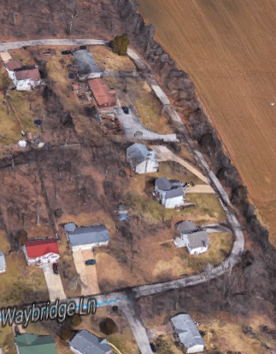
Future Planned Road Repairs
Buckboard (bottom of the hill to corner)
$28,000
Install drainage tiles, repair
existing structure, repave

Slide 18
State of the Subdivision (Cont)
Snow plowing: Snow plowing is a 2 tier plan
Tier 1 = For light snow falls, only steep hills and entrances will be salted and plowed.
Tier 2 = For heavy snow falls, most paved roads will be salted and plowed

Slide 19
Assessments and Revenue
Assessments:
2018 Assessments will be mailed out on May 1 and due on June 30.
A 2nd bill will be mailed July 1st to any unpaid account that will include late penalties.
Notes:
The HOA will continue to work with any owner who contacts us to make payment arrangements.

Slide 20
FY 2017-2018 Assessment Revenues
INCOME & EXPENSE STATEMENT
Fiscal year 2017-18
 | Bank Balance on: |  | 1-May-17 | $25,914.60
 | INCOME
 | Year | Month | General Assessment Fund | Street Assessment Fund | Past Due Collections
 | 2017 | May | $8,050.00 | $24,928.70 | $819.00
 | 2017 | June | $15,765.00 | $34,099.15 | $2,388.56
 | 2017 | July | $2,675.00 | $11,344.00 | $25.00
 | 2017 | August | $1,350.00 | $5,980.00 | $1,453.66
 | 2017 | September | $290.00 | $1,433.75 | $1,590.31
 | 2017 | October | $935.00 | $655.00 | $519.00
 | 2017 | November |  | $985.00 | $4,154.73
 | 2017 | December | $150.00 | $980.00 | $2,076.94
 | 2018 | January | $130.00 |  | $809.37
 | 2018 | February | $75.00 | $325.00 | $625.00
 | 2018 | March | $375.00 | $1,571.67 | $3,108.47
 | 2018 | April |  | $50.00 | $2,904.72
 | Totals |  | $29,795.00 | $82,352.27 | $20,474.76
 | Total collected for |  | 2017-18 | $132,622.03
 | + Bank Balance on: |  | 1-May-17 | $25,914.60
 | Total Funds Available: |  |  | $158,536.63

Slide 21
FY 2017 – 2018 Expenses
Administrative Budget Expenses
2017-18 |  | Amount Spent | Amount Budgeted | Over/Under
Legal Fees |  | $4,293.09 | $3,000.00 | -$1,293.09
Office Expenses |  | $541.31 | $1,050.00 | $508.69
Website |  | $139.98 | $800.00 | $660.02
Postage |  | $478.76 | $800.00 | $321.24
Street Lights |  | $0.00 | $1,350.00 | $1,350.00
P.O. Box |  | $96.00 | $100.00 | $4.00
Miscellaneous |  | $298.49 | $500.00 | $201.51
Insurance |  | $2,219.00 | $10,800.00 | $8,581.00
Common Ground/Lake |  | $14,360.00 | $5,475.00 | -$8,885.00
General Meeting |  | $1,333.15 | $300.00 | -$1,033.15
Emergency Fund |  | $0.00 | $5,000.00 | $5,000.00
Overpayment\Refund |  | $50.00 | $0.00 | -$50.00
Total Admin Expenses |  | $23,809.78 |  | $5,365.22
Street Budget Expenses
2017-18 |  | Amount Spent | Amount Budgeted | Delta
Road Repair |  | $105,110.77 | $100,625.00 | -$4,485.77
Snow Removal |  | $3,625.00 | $12,000.00 | $8,375.00
Total Street Expenses |  | $108,735.77 |  | $3,889.23
Total Expenses from both funds: |  |  | $132,545.55

Slide 22
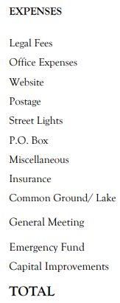
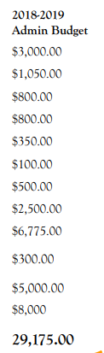
2018 Admin. Assessment Budget
This budget was approved in Sept 2017 and goes into effect on May 1, 2018.

Slide 23
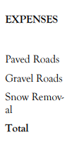
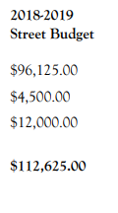
2018 Street Assessment Budget
This budget was approved in Sept 2017 and goes into effect on May 1, 2018.

Slide 24
Collections and Legal Actions
Last year we reported 17 accounts that were overdue and have exceeded the limits set and were sent to our legal representative
6 accounts have either settled or are making payments.
11 accounts had court papers filed two weeks ago
34 accounts were sent 2 years ago, 5 are still outstanding.

Slide 25
VOTING ITEM #1: Amendment to the Indentures
Shall Section 5.3 of the Indentures be changed to require the annual meeting of owners to take place in the last month of the fiscal year (currently April) instead of each September? It would still require at least one general meeting per year?
This will allow the meeting contents pertaining to the fiscal year to be more current as opposed to 5 months later.

Slide 26
VOTING ITEM #2: Continuation of Dept of Conservation Lake Grant
Shall the subdivision cancel the remaining years of its grant agreement with the Missouri Department of Conservation, losing the $750.00 per year we would receive for the lake over the next 4 years?
The subdivision receives $750 per year.
Requires the lake be open to the public.

Slide 27
VOTING ITEM #3: Single trash service throughout the subdivision
Shall a new section be added to the Indentures requiring all the homes within the subdivision to use a single trash service that would be selected by the trustees that would begin on Oct 1 2018?
Will help save the roads from by damage caused by multiple trash trucks using the roads daily.

Slide 28
VOTING ITEM #4: Election of trustee:
1 trustee is up for election or you can write in a candidate.
The 2018-2019 budgets that go into effect on May 1, 2018 were approved by vote in Sept 2017. The 2019-2020 will be voted on before they go into effect on May 1, 2019.

Slide 29
Ballot Items (cont)
2 Volunteers Needed for Ballot Count:
We will schedule a date to do the official ballot count and validation. This usually takes an average of 90 minutes.
Please notify one of the Board members if you are able to help out.
Plan is to count them next Monday evening.

Slide 30
DCS Waste Systems
3 year contract
2018 and 2019 – $14.50 per month (billed quarterly)
2020 - $14.94 per month (billed quarterly)
Use your own trash can or
$2 per month rental (DCS will repair or replace if damaged)

Slide 31
DCS Waste Systems
Recycling $6 per month
  DCS supplies recycling can at no additional charge
Yard Waste $9 per month (3 month minimum)
  Offered year round
Bulk pickup available, schedule with office

Slide 32
DCS Waste Systems
DCS currently has the vast majority of the subdivision as customers
DCS is the only company to put in writing they will use smaller trucks, because they only use the small trucks.

Slide 33
Thank you!!
The trustees would like to thank all of the homeowners who have stepped up to volunteer at the various projects completed within our community this past year.
We look forward to all we can accomplish in the next year with your help!

Slide 34
Questions and Answers
Please be respectful of others point of view
We have a limited amount of time remaining, if we don’t get to your question, leave it with us and we will answer it
A copy of all questions and answers will be provided to all lot owners along with the election results via the website and the next newsletter.

